Slide 1
PROJECT TITLE
CAPSTONE PROJECT
Secure Data Hiding In Images Using Steganography
Presented By : Padmavati Koppad
College Name & Department : I2IT,Pune (BE-IT)

Slide 2
OUTLINE
Problem Statement
Technology used
Wow factor
End users
Result
Conclusion
Git-hub Link
Future scope

Slide 3
Problem Statement
In an era of increasing digital communication, the security of sensitive data is a major concern. Traditional encryption techniques secure data but may raise suspicion when intercepted. Steganography provides a solution by hiding messages within images in a way that does not visibly alter the original file. This project aims to implement an image steganography system to securely embed and extract hidden messages inside images.

Slide 4
Technology used
Programming Language: Python
Libraries:
OpenCV – Image processing
NumPy – Pixel manipulation
Cryptography (optional) – Encrypting the hidden text
File Formats: .jpg, .png,

Slide 5
Wow factors
Invisible Message Encoding – Hidden messages do not distort the image visibly
Password Protection – Ensures only authorized users can decrypt the message
Least Significant Bit (LSB) Encoding – Enhances security by modifying only small pixel bits
Compact & Efficient – Supports large messages without bloating image size
Future Expansion – Can be extended to videos & audio steganography.

Slide 6
End users
Cybersecurity Experts – For secure communication
Journalists & Whistleblowers – To transmit confidential information safely
Government & Intelligence Agencies – Covert communication in digital media
Artists & Digital Creators – Embedding signatures in artwork invisibly
General Users – Hiding personal data in plain sigh

Slide 7
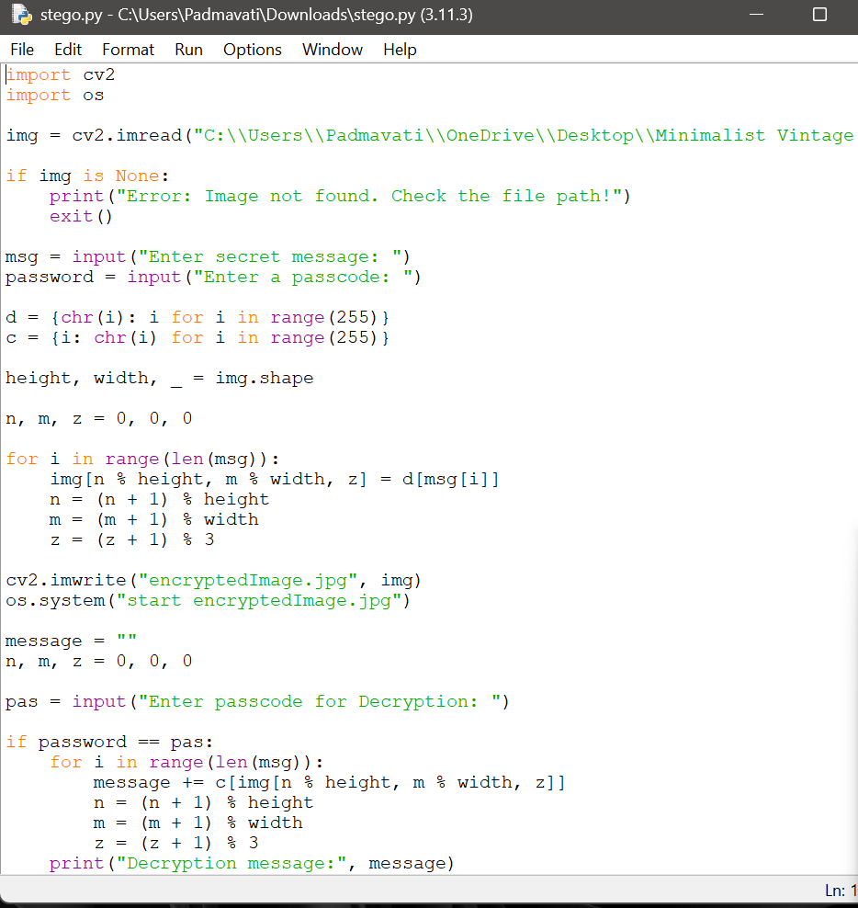
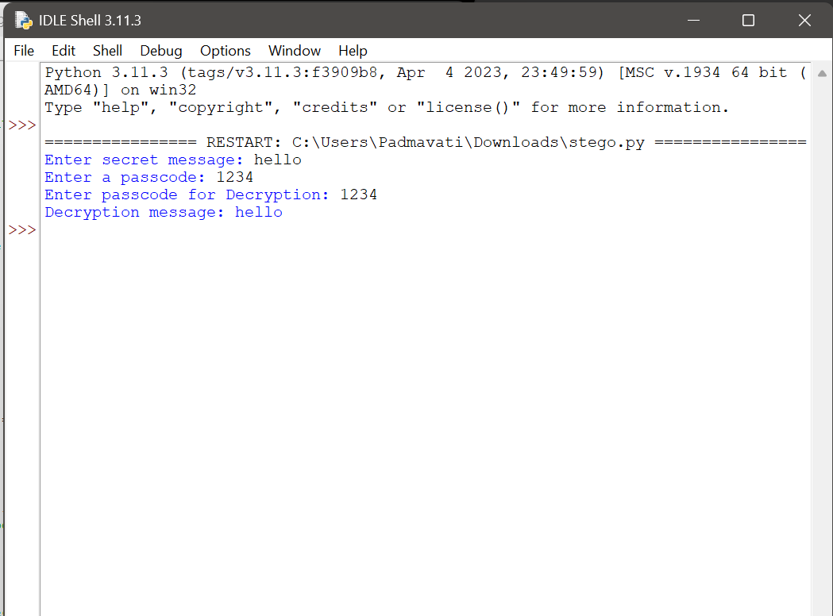
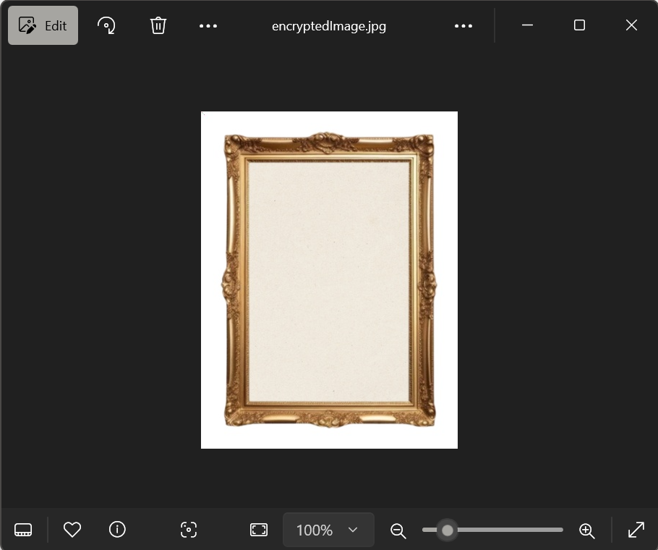
Results

Slide 8
Conclusion
This project demonstrates how image steganography can be used for secure and hidden communication. By leveraging pixel manipulation techniques, sensitive data can be embedded into images without detection. With further improvements such as AES encryption, enhanced LSB techniques, and support for videos, this approach can serve as a robust method for secure information exchange in the digital age.

Slide 9
GitHub Link
https://github.com/cele-cinnabar/imageSteganography.git

Slide 10
Future scope(optional)
The future of image steganography includes stronger encryption mechanisms like AES and RSA for enhanced security. It can be extended to video and audio steganography for broader applications. Machine learning can improve adaptive encoding, making detection even harder. Mobile and web-based implementations will make it more accessible. Advanced steganalysis protection techniques will help prevent detection by forensic tools.

Slide 11
THANK YOU

